Slide 1
Multiplying Decimals Unit
EQ: How do I multiply decimals?
Day 1

Slide 2
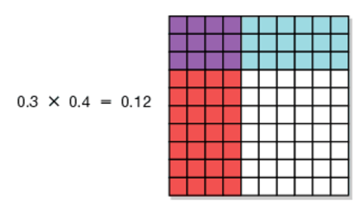
Activator: Glue steps in math journal. Let’s check out a problem:

Slide 3
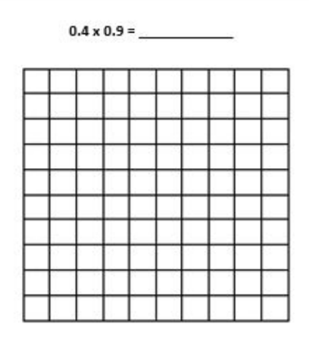
Practice

Slide 4
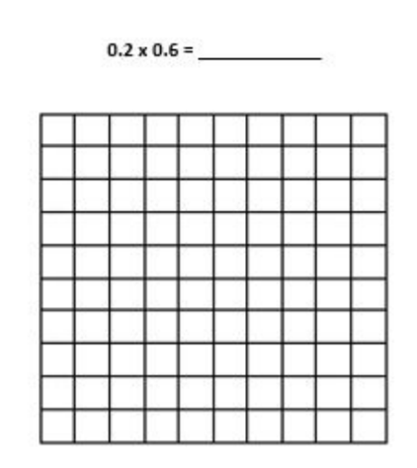
Practice

Slide 5
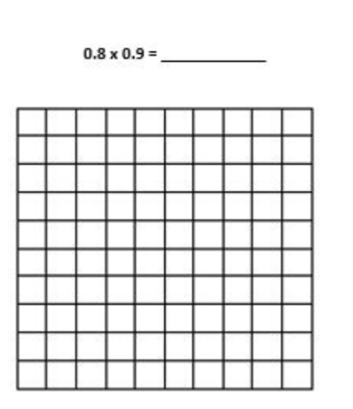
Practice

Slide 6
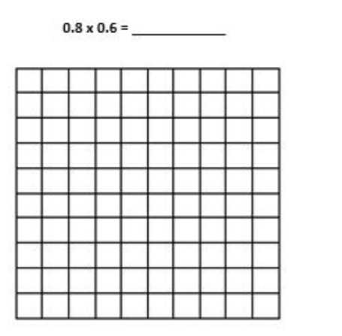
Practice

Slide 7
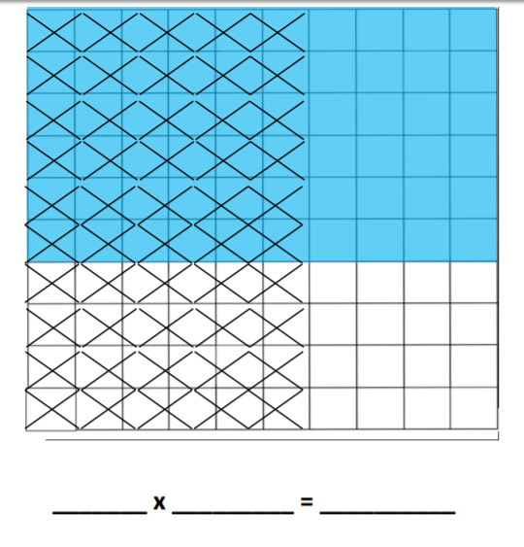
What equation does the model represent?

Slide 8
Guided Math

Slide 9
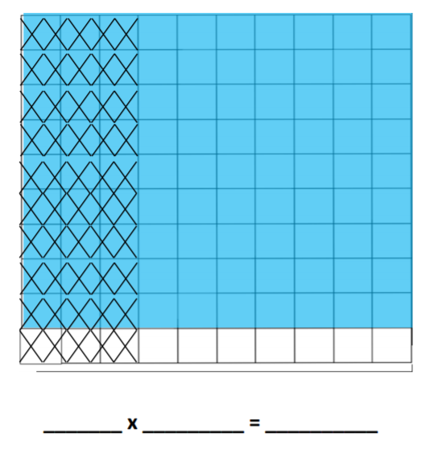
Closing: What equation does the model represent?

Slide 10
Multiplying Decimals Unit
EQ: How do I multiply decimals by whole numbers?
Day 2

Slide 11
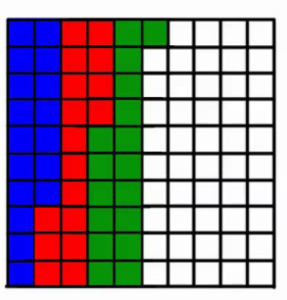
Activator: Glue steps in math journal. Let’s check out a problem:

Slide 12
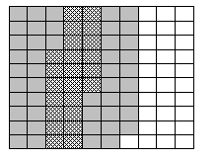
Write the equation that goes with the grid and then solve the problem.

Slide 13
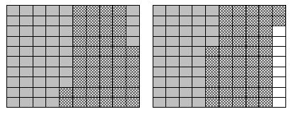
Write the equation that goes with the grid and then solve the problem.

Slide 14
0.4 x 3 = ________

Slide 15
0.21 x 4 = ________

Slide 16
0.31 x 5 = ________

Slide 17
Guided Math

Slide 18
Summarizer .21 x 3 = .63 What do you notice about the answer?

Slide 19
Multiplying Decimals Unit
EQ: How do I multiply decimals?
Day 3

Slide 20
Activator:

Slide 21
Multiply
34.6 x 28 = _____________

Slide 22
Multiply
80.7 x 94 = _____________

Slide 23
Multiply
5.19 x 3 = ______________

Slide 24
Multiply
0.29 x 18 = _______________

Slide 25
Multiply
0.65 x 7 = _______________

Slide 26
Guided Math

Slide 27
Closing
Olivia bought 0.7 grams of gold that cost $49 per gram. How much did the gold cost?

Slide 28
Multiplying Decimals Unit
EQ: How do I multiply decimals?
Day 4

Slide 29
Learnzillion Video
Multiply Decimals
https://learnzillion.com/lesson_plans/8152-multiply-decimals

Slide 30
Review

Slide 31
Practice Page

Slide 32
Closing
Omar spends $0.87 a day buying a doughnut for breakfast. How much will he spend in December?

